Slide 1
Android App Review Analysis
Auto-generated report
August 30, 2025

Slide 2
Problem Statement
To identify user pain points and sentiment from Google Play reviews to help improve the app.
Generated by YourName | Slide 2

Slide 3
Data Source
• Google Play Store
• Package: com.instagram.android
Scraped file: App_Reviews.csv
Generated by YourName | Slide 3

Slide 4
Data Cleaning Approach
Applied basic regex, stopwords removal and lemmatization
Output file: Cleaned_Reviews.csv
Generated by YourName | Slide 4

Slide 5
Sentiment Analysis
Used TextBlob to assign polarity-based sentiment to each review
Output file: Reviews_With_Sentiment.csv
Chart: sentiment_pie.png
Generated by YourName | Slide 5

Slide 6
Filtered Reviews (1–4 Stars)
Filtered reviews with score 1–4 to detect complaints
File: Filtered_1_4_Star_Reviews.xlsx
Generated by YourName | Slide 6

Slide 7
Auto-Categorization using GPT-3.5
Used GPT-3.5 to assign issue categories to each review
Example: Login Issue, Payment Failure
Output file: Auto_Categorized_Reviews.xlsx
Generated by YourName | Slide 7

Slide 8
Clustering via GPT-3.5
Grouped reviews into higher-level clusters
Output file: Clustered_Reviews.xlsx
Generated by YourName | Slide 8

Slide 9
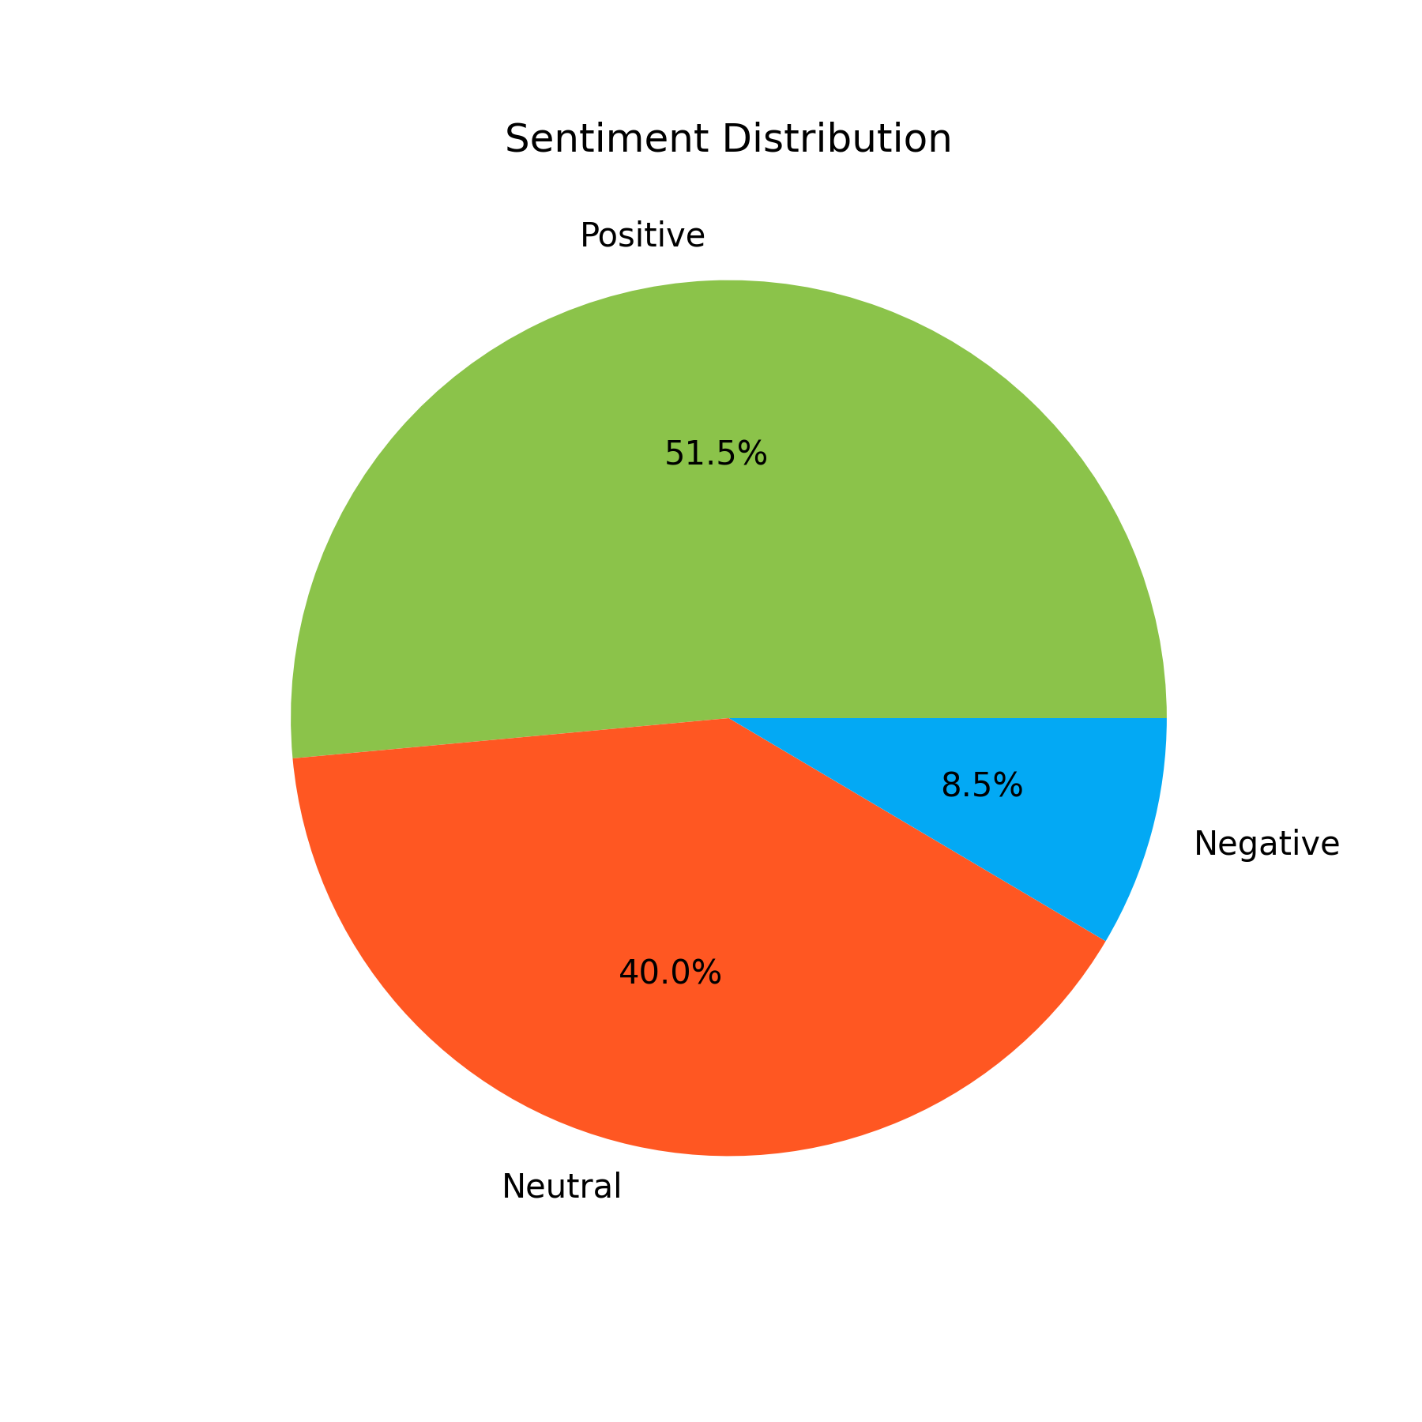
Sentiment Distribution (Pie Chart)
This chart shows the overall sentiment of app reviews. A large share of negative
reviews suggests areas of concern, such as app crashes or poor support. Positive
reviews reflect satisfaction with ease of use and features.
Generated by YourName | Slide 9

Slide 10
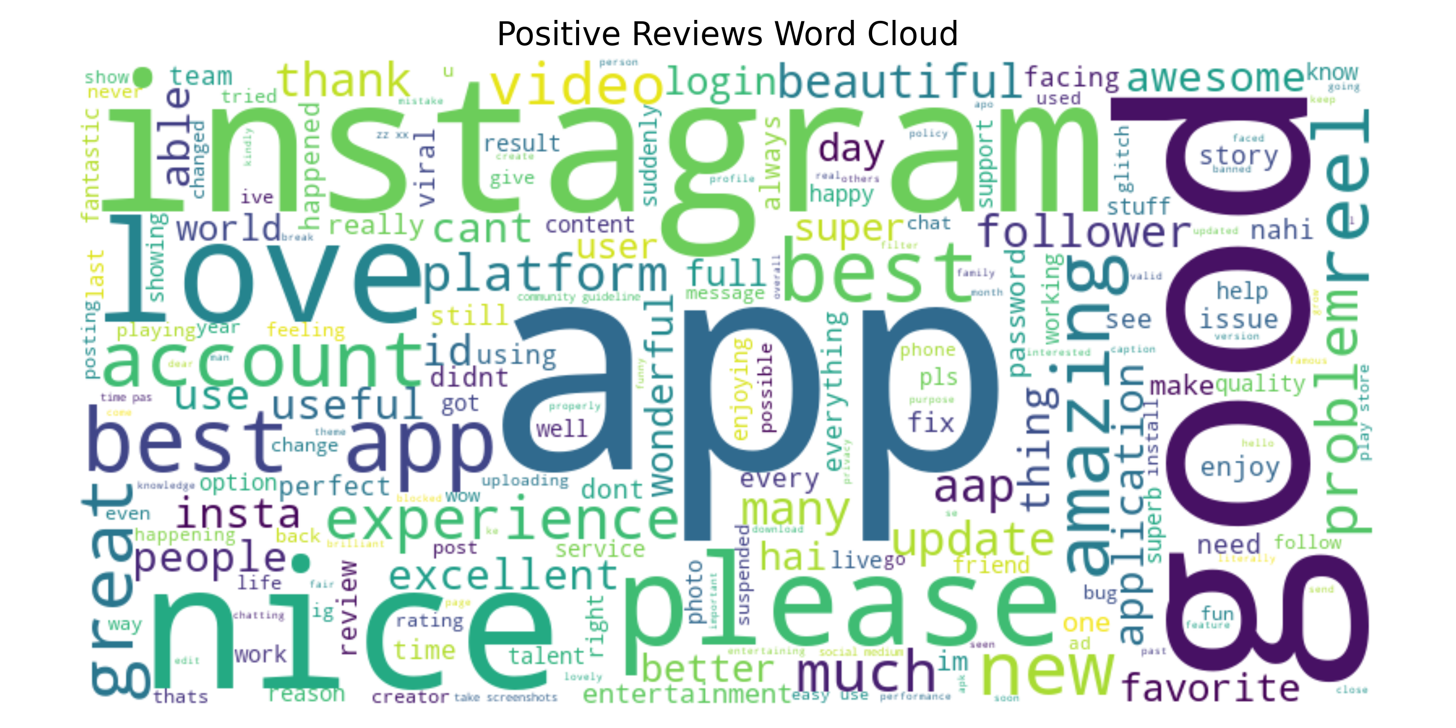
Positive Reviews Word Cloud
Frequent words in positive reviews include 'easy', 'interface', and 'returns' —
indicating satisfaction with usability and performance.
Generated by YourName | Slide 10

Slide 11
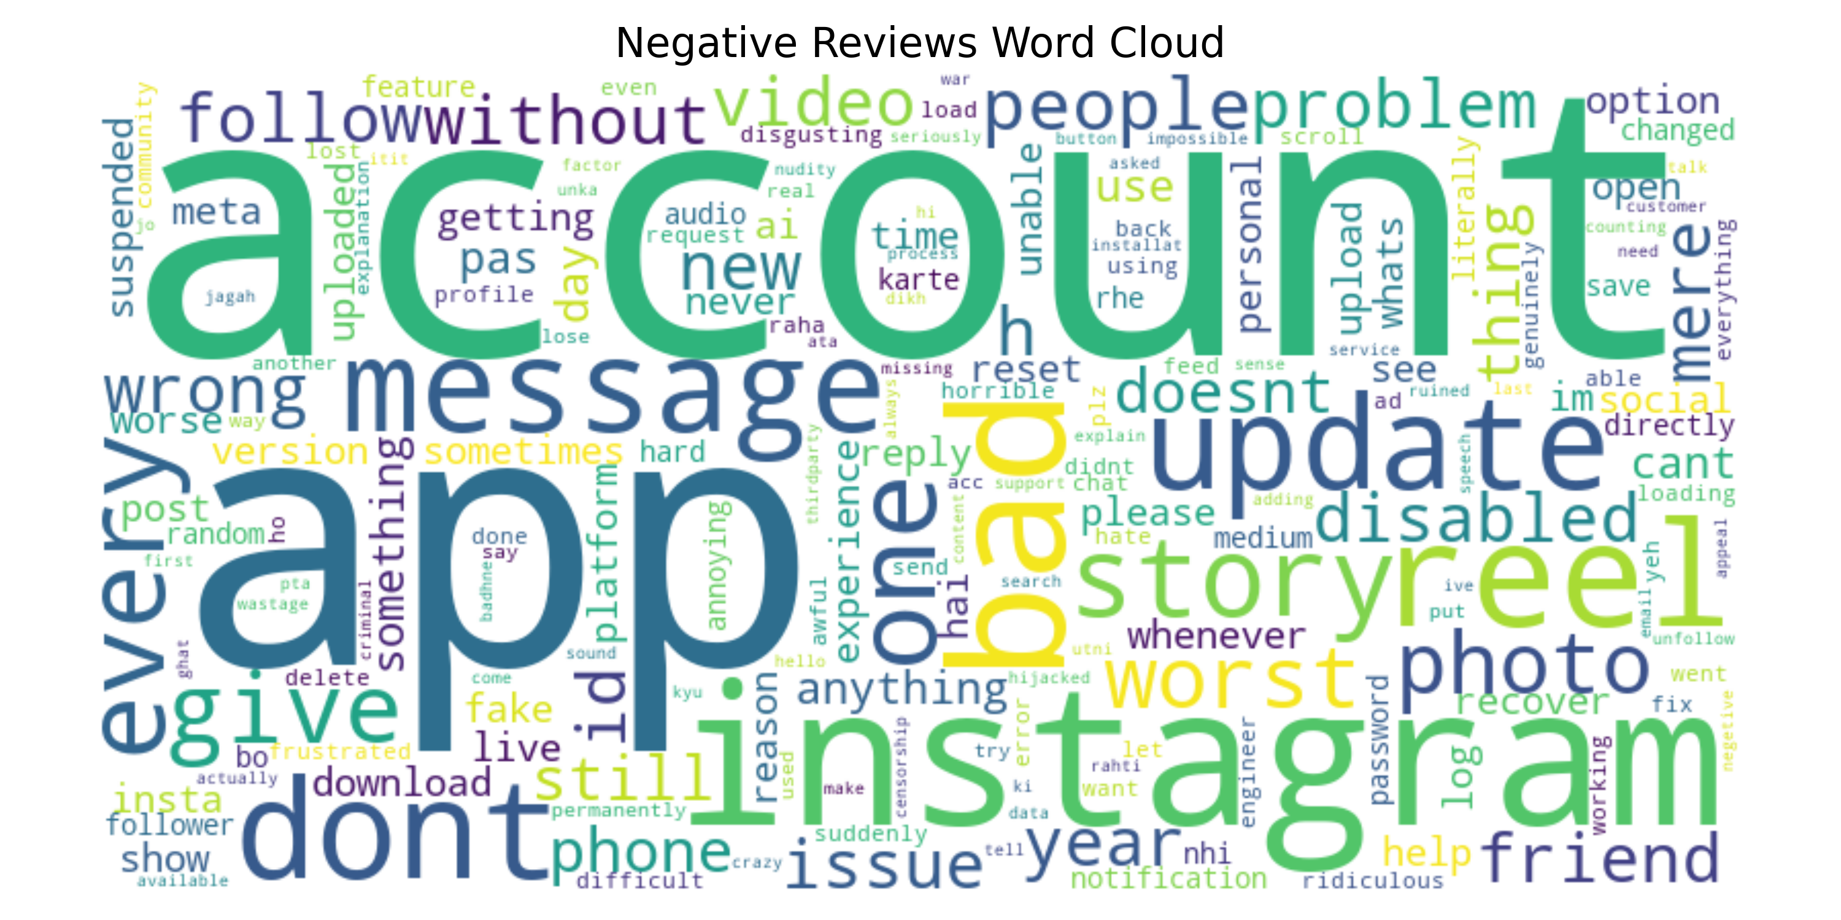
Negative Reviews Word Cloud
Negative reviews often mention 'login', 'issue', 'delay', and 'support' —
highlighting key pain points that frustrate users.
Generated by YourName | Slide 11

Slide 12
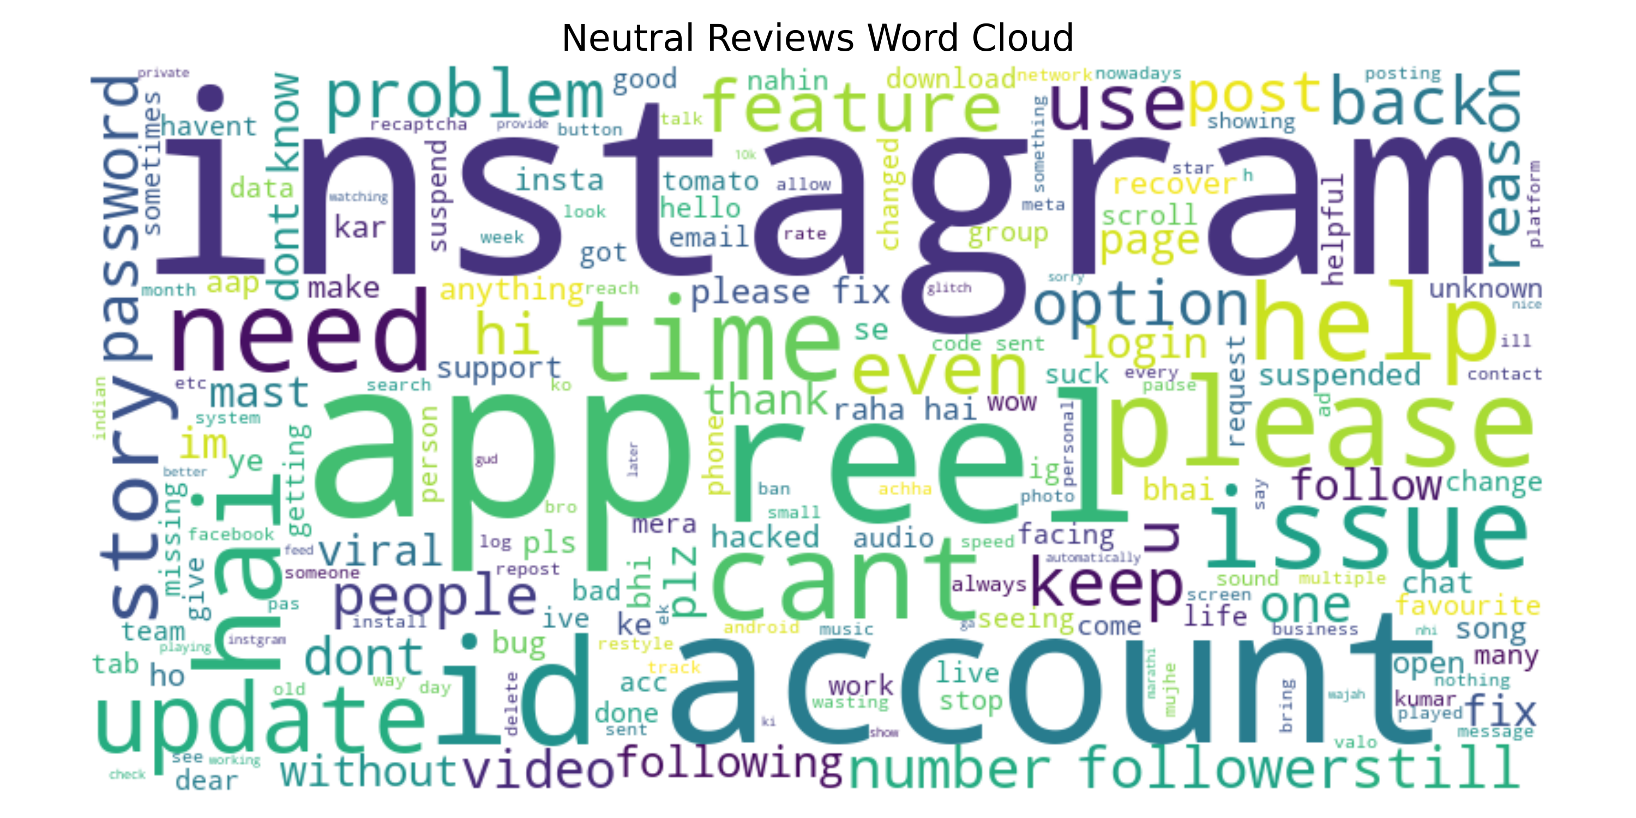
Neutral Reviews Word Cloud
Neutral reviews contain suggestions or feature requests without strong emotional
tone. Common themes include improvements and feedback.
Generated by YourName | Slide 12

Slide 13
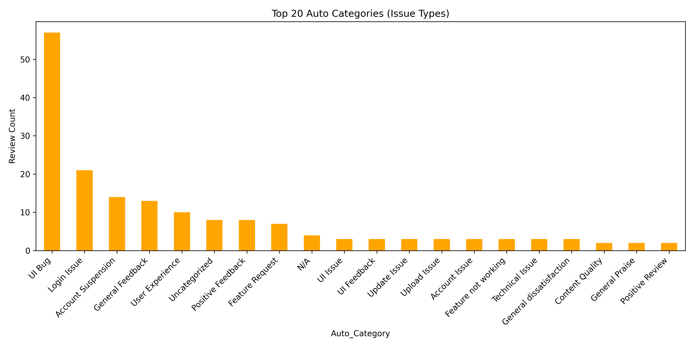
Top 20 Auto Categories (Bar Chart)
This bar chart shows the most frequent auto-categorized issue types. Login,
payment, and KYC issues dominate.
Generated by YourName | Slide 13

Slide 14
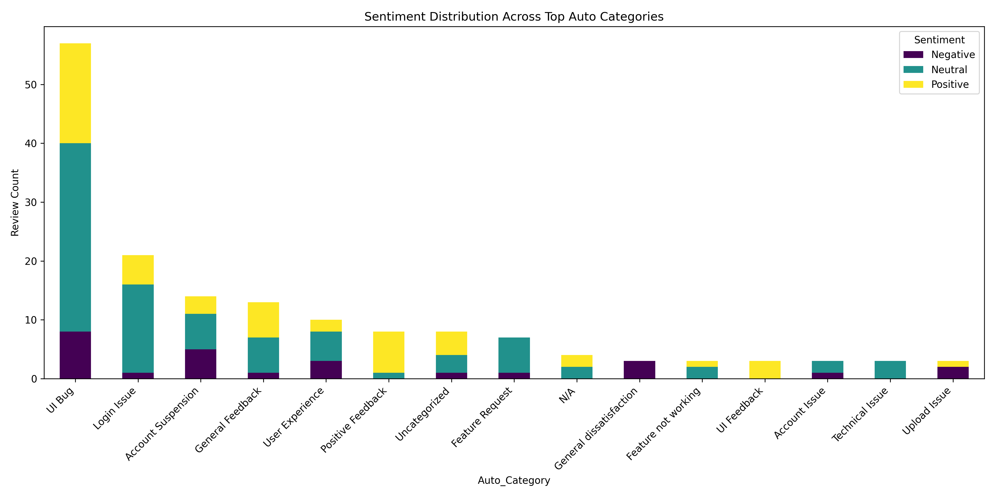
Sentiment Across Top Auto Categories
This stacked bar chart shows how sentiment varies by issue category. Login and
support issues are mostly negative, while some categories like feature requests
show more neutral or positive sentiment.
Generated by YourName | Slide 14

Slide 15
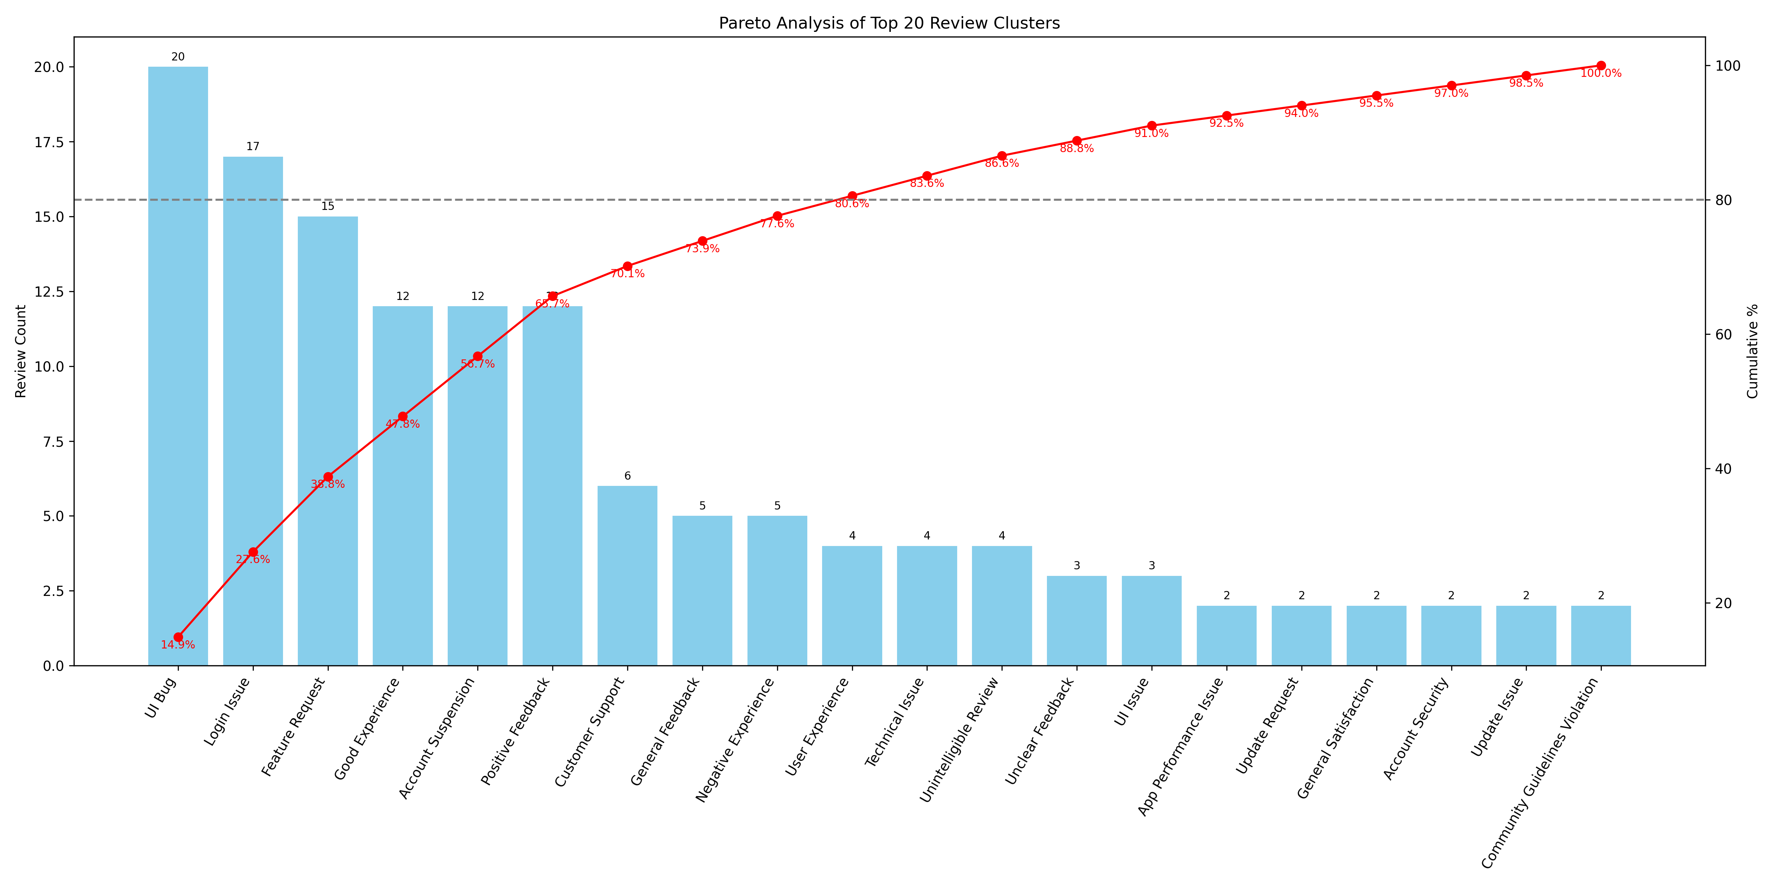
Pareto Analysis of Top 20 Clusters
This Pareto chart visualizes the top 20 review clusters, showing their
individual frequencies and cumulative contribution. It helps identify the few
key issues that account for the majority of complaints, aligning with the 80/20
principle for prioritization.
Generated by YourName | Slide 15

Slide 16
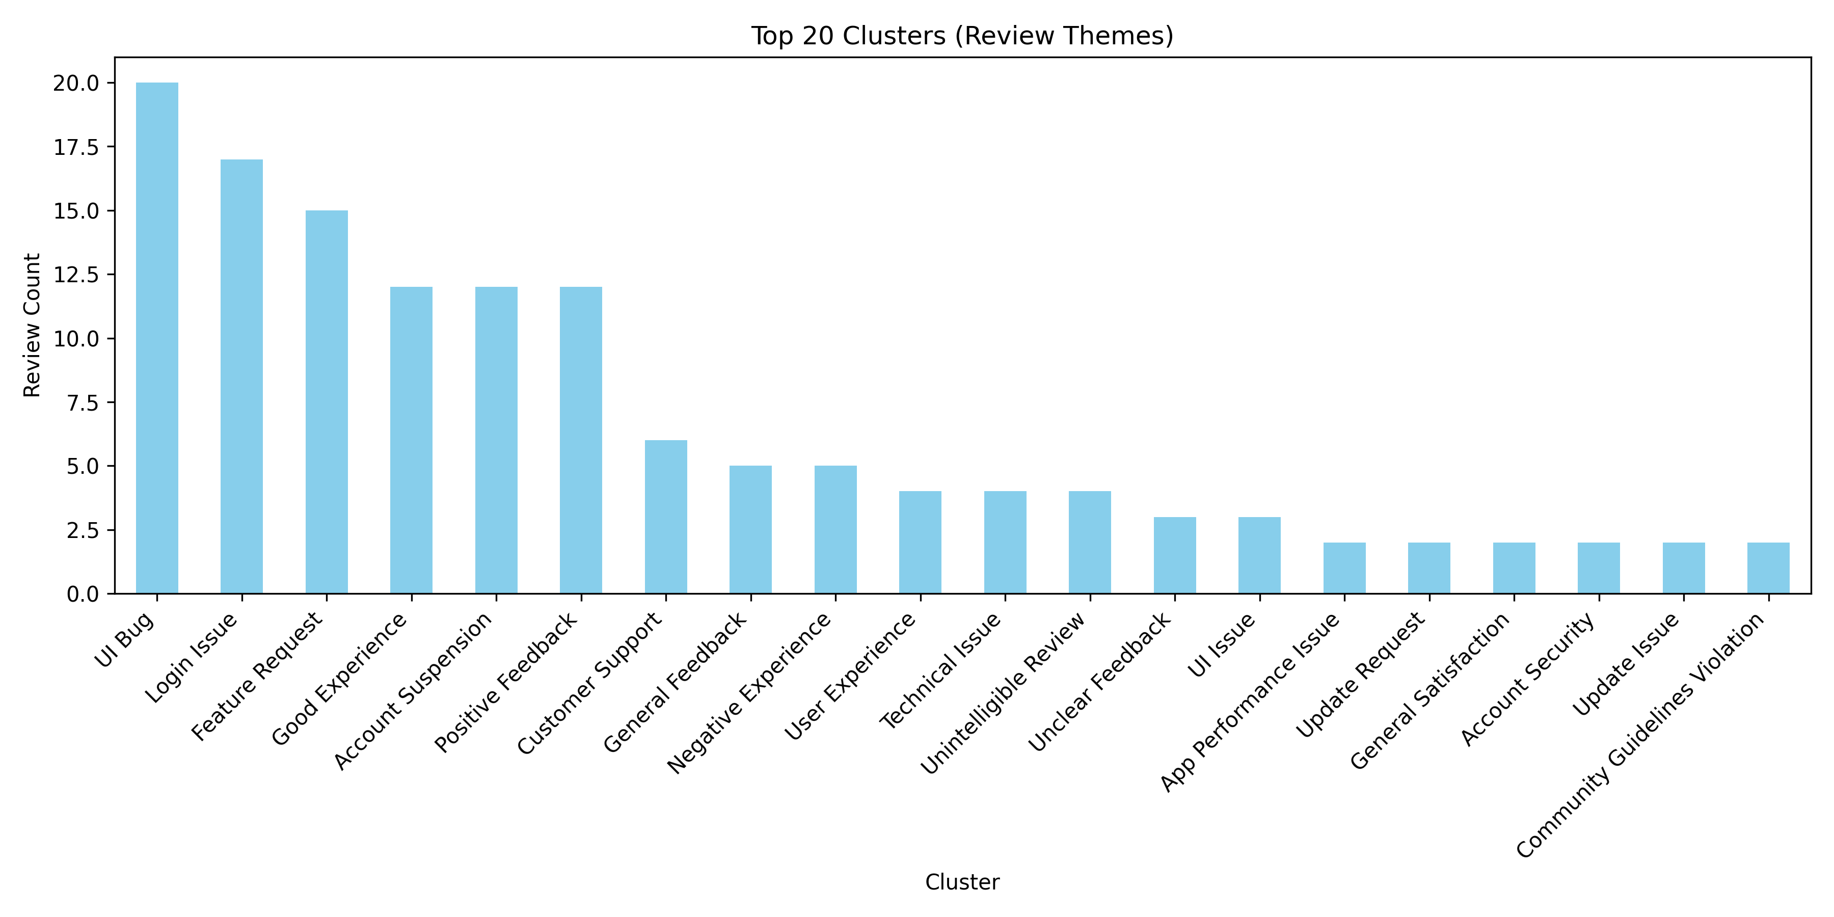
Top 20 Clusters (Bar Chart)
This chart visualizes the most common clusters found using GPT-based grouping.
It highlights the frequency of each recurring theme.
Generated by YourName | Slide 16

Slide 17
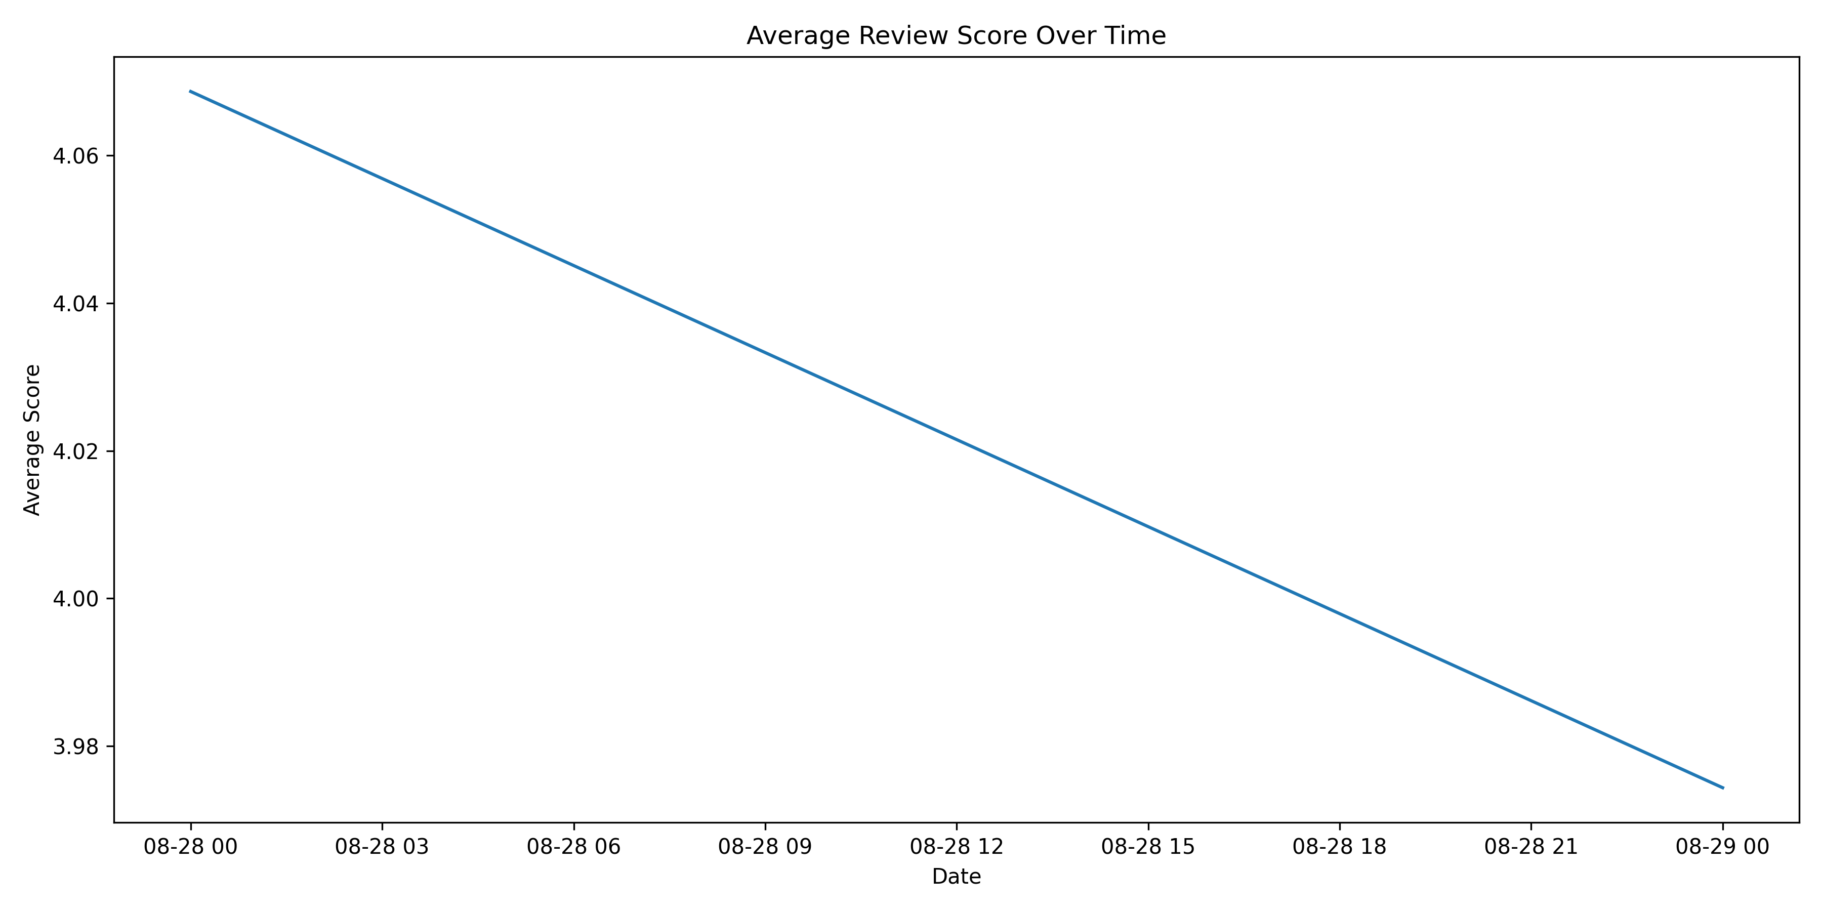
Time-Series Analysis of Review
This time-series plot shows the average review scores over time, helping to
identify any recent dips or improvements in user sentiment that may correlate
with app updates or feature releases.
Generated by YourName | Slide 17

Slide 18
Key Findings
Based on sentiment, categorization, and cluster frequency
1) Overall sentiment: Positive 51.5%, Negative 8.5%, Neutral 40.0%. Interpretation: Strong positive majority indicates product strengths, but the negative tail highlights recurring frictions that affect retention. Track weekly sentiment deltas and prioritize issues causing negative spikes.
2) Topic signals & user praise: Top LDA topics emphasize: app nice good best update, reel account new instagram follower, instagram account id platform cant, app good instagram reel best. This suggests core capabilities (e.g., charts, funds, usability) are perceived as strengths by many users. Leverage these strengths in messaging and prioritize feature polish that amplifies this positive feedback.
3) Pareto concentration: top clusters = UI Bug, Login Issue, Feature Request, Good Experience, Account Suspension. Analysis (Pareto) shows a small number of issue categories drive most complaints — fixing those yields outsized impact. Use Top_20_Cluster_Stats.xlsx to identify exact counts and prioritize the top 3 clusters for an immediate ROI.
4) UX & stability hotspots: login/authentication failures (OTP, lockouts). These issues cause immediate task failure and generate high-severity support tickets; reproduce top issues with covered steps, add telemetry to capture failure contexts (app-version, device, network), and introduce guards in the UX to prevent fatal flows.
5) Support & trust signals: fees / hidden charges raising trust concerns, slow or unsatisfactory customer support experience. Billing disputes, fraud flags and slow support increase churn risk. Track time-to-resolution, dispute volume, and repeat tickets and set targets (e.g., resolve critical financial tickets < 24 hours).
Generated by YourName | Slide 18

Slide 19
Recommendations
Actionable recommendations based on analysis
1) Run a 30-day Pareto Triage Sprint: - Focus a cross-functional team on the top 3 clusters (engineering, QA, product, ops). - Reproduce, patch, and validate fixes; push phased hotfixes and monitor metrics post-release. - Track cluster counts daily to confirm impact.
2) Improve UX flows & observability: - Simplify login and KYC flows (clear errors, inline help, retry paths) and reduce friction points. - Instrument detailed telemetry (error codes, device, network) and create dashboards to find root causes. - Add synthetic tests to catch regressions before release.
3) Payment reliability & transparency: - Display clear fee breakdowns and transaction status; provide immediate next-action guidance on errors. - Implement automatic retries for transient failures and create a fast-track billing-dispute process. - Provide ops dashboard to manage dispute SLA (<48h for billing issues).
4) Support model upgrade & SLAs: - Deploy AI-assisted triage to resolve common queries instantly and gather structured info for agents. - Route critical financial/fraud tickets to a high-priority queue and measure first-contact resolution. - Publish expected SLAs in-app so customers know what to expect.
5) Roadmap transparency & closed-loop feedback: - Publish a concise roadmap addressing top-requested features and provide beta access to engaged users. - After each major release, re-run sentiment & cluster analysis and communicate outcomes in release notes. - Use metrics (sentiment delta, cluster counts, NPS) to measure success.
Generated by YourName | Slide 19

Slide 20
Tools & Technologies (detailed)
Core libraries, models and what they do
Python 3.9+ — codebase (pandas 1.x, numpy 1.x) for data processing
google-play-scraper — scrape reviews from Play Store
NLTK & TextBlob — preprocessing, stopwords, lemmatization, polarity sentiment
Gensim LDA — unsupervised topic modeling (num_topics configurable)
OpenAI embeddings (text-embedding-3-small) — semantic vectors for clustering
OpenAI Chat (gpt-3.5-turbo) — human-like cluster names, categorization, recommendations
scikit-learn (KMeans) — clustering; consider UMAP+HDBSCAN for production
Matplotlib + WordCloud — charts and word-clouds for slides
python-pptx — automated PowerPoint report generation
python-dotenv, tenacity — env management and robust API retries
Generated by YourName | Slide 20

